Slide 1



Visvesvaraya Technological University, Belagavi. PES Institute of Technology and Management, Shivamogga DEPARTMENT OF COMPUTER SCIENCE & ENGINEERING (DATA SCIENCE) MINI-PROJECT PRESENTATION (SUBJECT CODE:BCD586) PROJECT TITLE:LOG ANALYZER
Visvesvaraya Technological University, Belagavi. PES Institute of Technology and Management, Shivamogga
DEPARTMENT OF COMPUTER SCIENCE & DESIGN MINI-PROJECT PRESENTATION (SUBJECT CODE:BCG586)
Presented by :
Name : USN :
R P nagashri sajjan 4pm22cd036
Sinchana p 4PM22cd050
SoundaryA s p 4PM22Cd053
Zeenath banu s 4PM22cd063
Project Guide
Dr.Lokanna kadakolmath
Assistant Professor
Dept of CSDS, PESITM.
Project Coordinator
Dr.Lokanna kadakolmath
Assistant Professor
Dept of CSDS, PESITM.
Head Of the Department
Dr.Sunitha
Professor
Dept of CSDS, PESITM.

Slide 2
Table of Contents
Abstract
Introduction
Problem Statement
Objectives
methodology
Algorithms Used
System Requirements
Conclusion

Slide 3
ABSTRACT
The Log Analyzer is designed to analyze system-generated requests by processing log files.
Logs contain details about request handling, including API calls, exceptions, and failures.
The project implements an interface to select and parse log files, extracting information such as request status, exceptions, and processing details.
This analysis helps in reducing the time required to manually go through log files and provides a graphical view of system performance.

Slide 4
INTRODUCTION
Every application works with three frameworks: frontend, middleware (API), and database.
Middleware (S-API) acts as a bridge between frontend and database, handling requests and generating logs.
Log files are critical for monitoring system performance and identifying issues during production.
Our system parses log files to provide quick insights into the number of requests processed, exceptions encountered, and system performance.

Slide 5
PROBLEM STATEMENTS
Analyzing large volumes of log files to detect issues is time-consuming. Manually identifying exceptions and understanding system request failures from log files is inefficient. Developers need a tool that parses logs quickly, identifies issues, and visually represents key performance metrics..

Slide 6
OBJECTIVES
Automate log file analysis to reduce manual inspection.
Provide meaningful insights into system requests and exceptions.
Graphically display the number of API calls, exception details, and request statuses.
Allow users to search and analyze specific exceptions to understand failure causes.
Improve system performance by identifying patterns of failure or success.

Slide 7
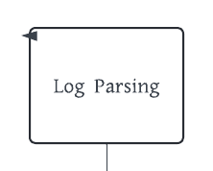
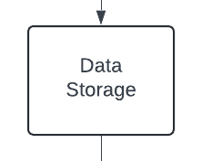
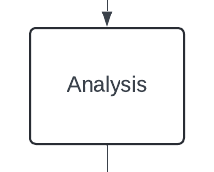
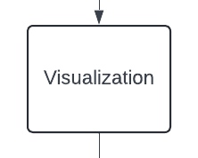
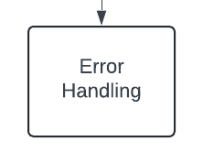
METHODOLOGY:-

Slide 8
Algorithm used : Regular Expression
Regular expression algorithm : plays a crucial role in parsing, filtering, and extracting meaningful information from log files.
Pattern Matching : Identify exceptions, timestamps, HTTP status codes using regex.
Capture Key Data : Extract error messages, stack traces, and failures.
Efficiency : Quickly scan large logs, focusing on issues.
Automation : Use regex with scripts for automated log parsing.
Visualize Metrics : Graph error trends and analyze performance.
Example : Extracting all lines in a log that contain the word “ERROR”:

Slide 9
SOFTWARE REQUIREMENTS
Programming Language: Python
Libraries for Visualization: Matplotlib, Seaborn, Plotly
Log Parsing: Custom parser for various log formats (plain text, JSON, CSV)
Data Storage: In-memory storage or lightweight database
Interface: File selection interface to choose log files
Error Handling: Mechanisms for dealing with missing or malformed logs

Slide 10
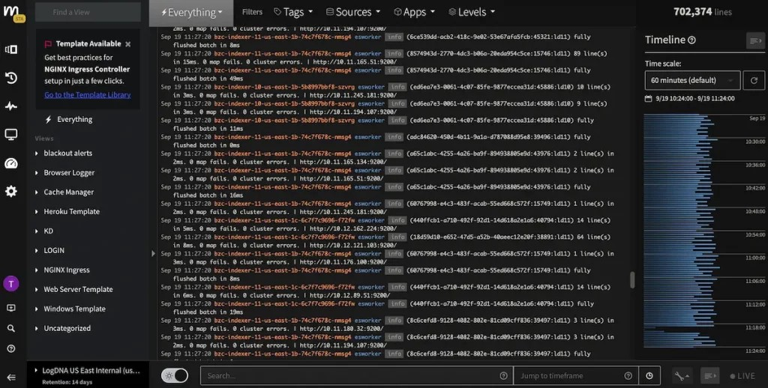
Log files

Slide 11
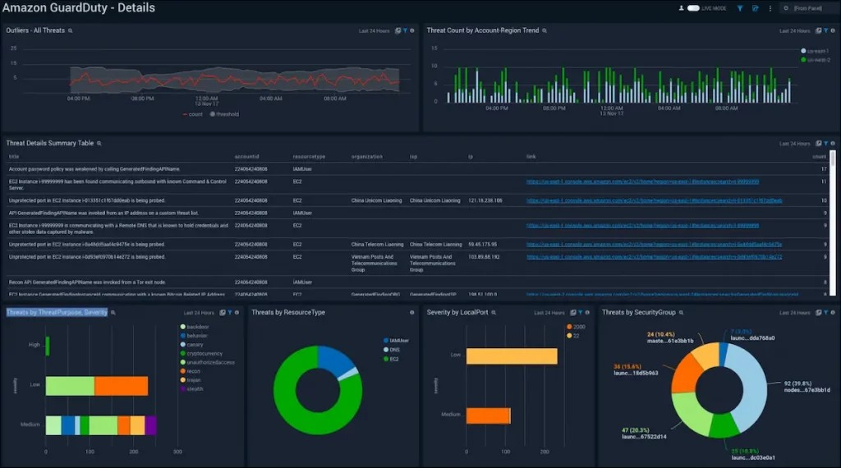
Graphical representation

Slide 12
CONCLUSION
The Log Analyzer significantly reduces the time needed to manually analyze system log files.
By providing graphical summaries of request status and exception details, the tool enhances visibility into system performance.
The project improves system monitoring and debugging, helping developers understand common failures and optimize request handling.
Future improvements could include real-time monitoring and more advanced error prediction.

Slide 13
THANK YOU!

